Slide 1

ACADEMIC WRITING
WEEK 1
NORLIDA ARIFFIN

Slide 2
INTRODUCTION TO ACADEMIC WRITING
Academic writing is writing which communicates ideas, information and research to the wider academic community.

Slide 3

The Writing Process
“A complex process with a number of operations going on simultaneously”
(Hedge, 1998)
Being motivated to write
Getting ideas together
Planning and outlining
Making notes
Making a first draft
Revising → planning → redrafting
Editing and getting ready for publication

Slide 4
Stage 1: Pre-Writing

Slide 5
Make sure you understand your assignment
Start by choosing a topic (if not given).
Narrow your topic.
Draft a main claim or thesis statement.
Do the research to find more information.

Slide 6
Before you start writing,
What knowledge do you have about the subject matter?
Why is it important to you?
Why did you select this particular topic?
You
Author
The most directly affected by the it
All audiences are constrained by certain elements: language, education level demanded by vocabulary, examples of references
What is the reason for writing it?
Most likely because it is an assignment
Audience
Purpose
Me
To get a good grade

Slide 7
Consider who is your audience (readers)
Levels of Formality: writing in a style that your audience expects and that fits your purpose is key to successful writing.
In-Group Jargon: Jargon refers to specialized language used by groups of like-minded individuals. Only use in-group jargon when you are writing for members of that group. You should never use jargon for a general audience without first explaining it.
Slang and idiomatic expressions: Avoid using slang (dope, fire, squad) or idiomatic expressions (piece of cake, under the weather) in general academic writing.
Biased language: Avoid using any biased language including language with a racial, ethnic, group, or gender bias or language that is stereotypical.

Slide 8

Formal vs Informal writing

Slide 9
Pre-writing strategies
Listing → a process of generating a lot of information within a short time by generating some broad ideas and then building on those associations for more detail.
Clustering → also called mind mapping or idea mapping, is a strategy that allows you to explore the relationships between ideas.
Freewriting → a process of generating a lot of information by writing non-stop for a predetermined amount of time. It allows you to focus on a specific topic, but forces you to write so quickly that you are unable to edit any of your ideas.
Wh- questions → who, what, where, when, why, how?

Slide 10
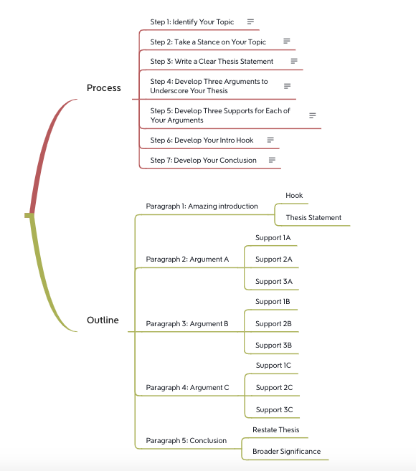

Slide 11
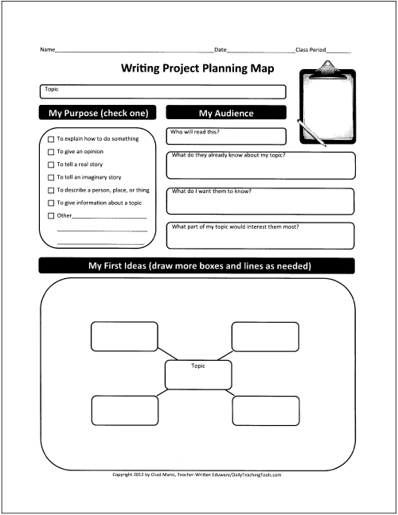
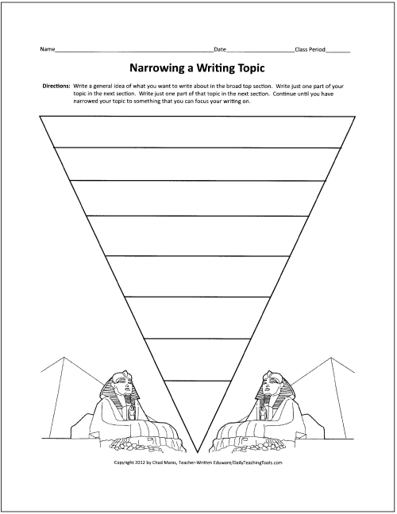

Slide 12
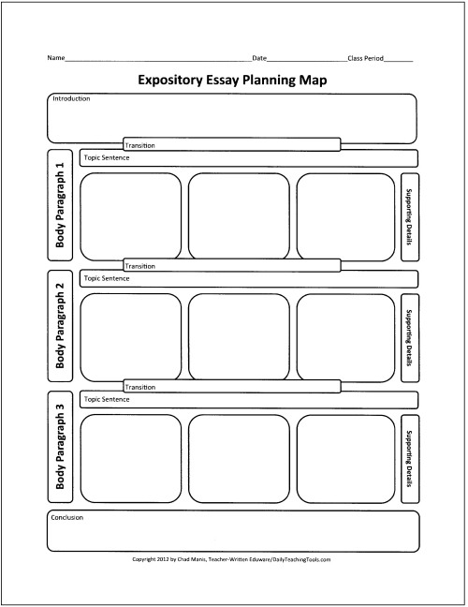
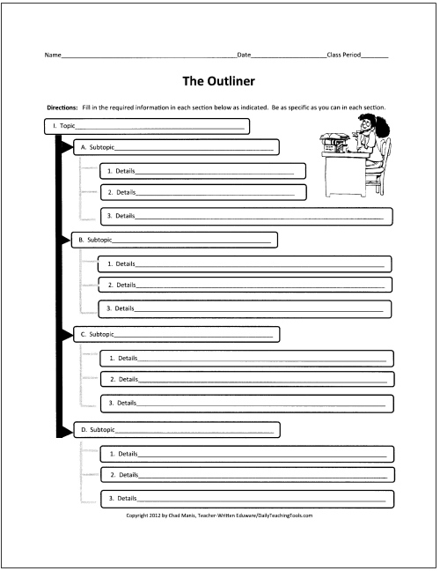

Slide 13
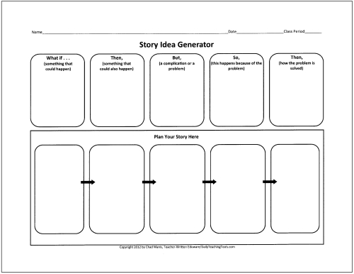
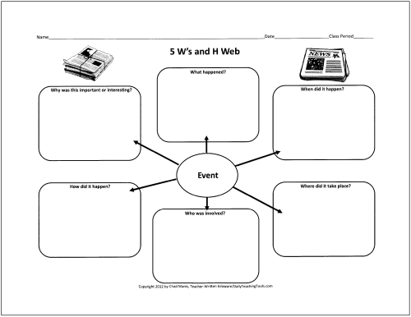

Slide 14
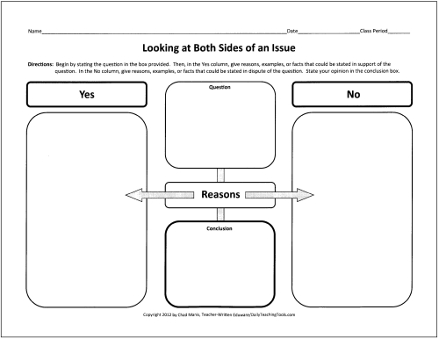
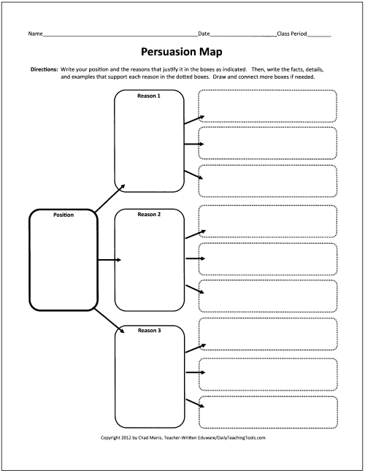

Slide 15
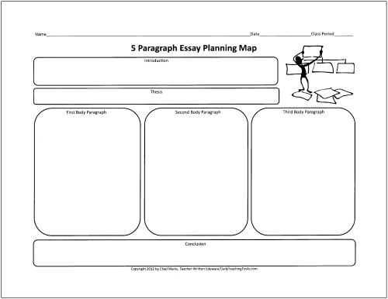
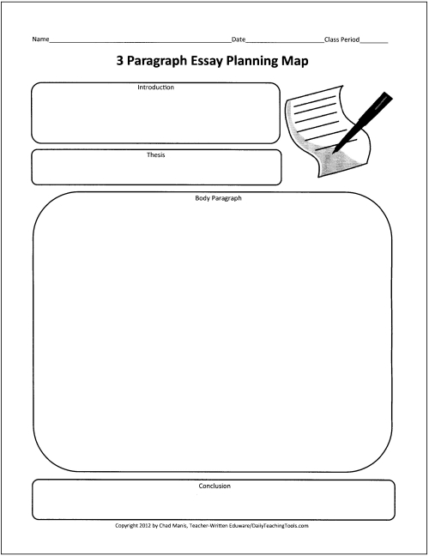

Slide 16

Describing experiences
Give one word/ words that can describe these objects/ situations:
Your favourite food
A sunny day at the beach
The last movie that you saw
Someone you love
Going for an interview

Slide 17
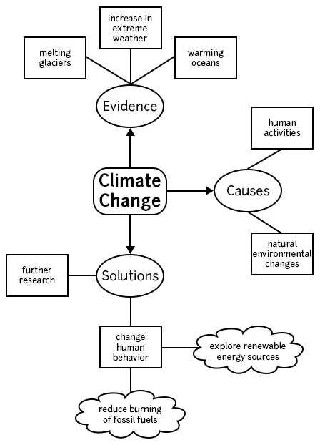

Slide 18
Class activity
In groups, discuss your topic and come out with a mind map for it. Your mind map should include 3 main points and each point must have short explanation and examples.
One representative will be chosen randomly from each group to present their mind map.
1) In what ways homework contributes to student performance?
2) Describe a favourite book or movie where the main character has to decide something difficult. What did you think about their choice?
3) What are your life goals?
4) How I get motivated.
5) The ideal modern teacher.

Slide 19

Thank you

